Slide 1



ADNAN Kureshi
(204550307049)
Harsh Vyas
(204550307006)
AnISH KArleKAR
(204550307031)
Jay SANGANI
(204550307014)

Slide 2
01.
INTRODUCTION
02.
PROBLEM DEFINITION AND USER REQUIREMENTS
contents OF THE PRESENTATION
03.
OBJECTIVES
04.
Technical Requirements

Slide 3
05.
FRONTEND
06.
BACKEND
contents OF THE PRESENTATION
07.
Detailed Description
08.
System Analysis and Design

Slide 4
09.
Data Dictionary :
10.
Implementation Work
contents OF THE PRESENTATION
11.
Future Enhancements
12.
Conclusion

Slide 5
INTRODUCTION

Slide 6
INTRODUCTION
Our project is an online store, it attempts to serve as a marketplace where people can sell their used or unwanted items.
People can make money by selling their scrap, and artists can purchase those items at low cost and make money by showcasing their creativity on them.
This creative items can be purchased by any user on our website.

Slide 7
CASE STUDY

Slide 8
CASE STUDY
E-Bay: Unnecessary products are sold at high price due to bidding.
OLX: Only provides platform for selling old products.
Amazon: Only provides platform for selling new products and refurbished products only.

Slide 9
Problem definition and User Requirements

Slide 10
PROBLEMS
As we can see the rising number of unemployment in our country. That’s why, We came up with an idea of our website “SCRAP UP”
People get rid from there unwanted items by throwing them as waste , which leads to pollution.
Increase of wasteland.

Slide 11
USER REQUIREMENT
Recyclable products and eco-friendly handcrafted products to sell.
Contribute in waste management of India.
Reviving of the Indian Handicrafts industry with a sustainable approach.

Slide 12
OBJECTIVES

Slide 13
OBJECTIVES
Our website offers the service of transforming outdated and uninteresting products into unique and useful ones.
Our website interlink art, creativity and waste into sustainable functional products handcrafted by local Indian Creators.
Any creative item on our website can be purchased by a user with ease.

Slide 14
TECHNICAL REQUIREMENTS

Slide 15
TECHNICAL REQUIREMENTS
Computer or Phone
Internet Browser

Slide 16
FRONTEND

Slide 17

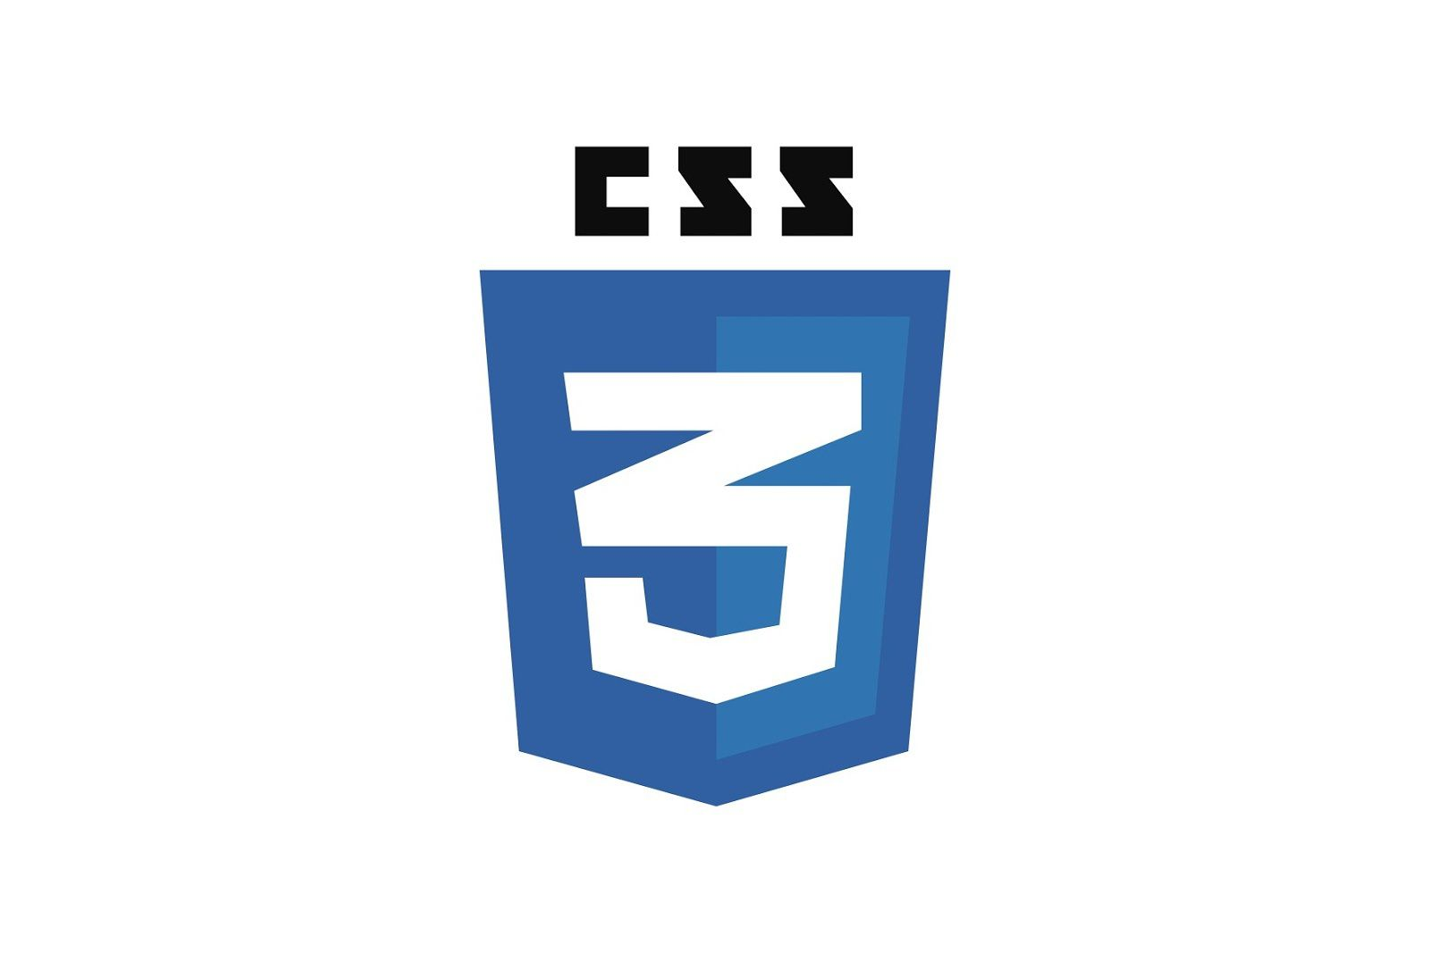


FRONTEND
HTML
CSS
JAVASCRIPT
BOOTSTRAP

Slide 18
BACKEND

Slide 19


BACKEND
PHP
MYSQL

Slide 20
MODULES

Slide 21
MODULES
User
Creator
Admin

Slide 22
MODULES INFORMATION
ROLES OF ADMIN
Registration
Login
Manage Buyer/Seller
Manage Creator
Manage Category
Manage Products
Manage Orders
Manage Payments
Manage Deliveries
Logout

Slide 23
MODULES INFORMATION
ROLES OF USER
•Registration
•Login
•Manage profile
•Sell/Buy Product
•Edit Products
•Remove Product
•Track Order
•Logout

Slide 24
MODULES INFORMATION
ROLES OF CREATOR
• Registration
• Login
• Manage Creator profile
• Manage Creator portfolio
• Sell/Buy Product
• Edit Products
• Remove Product
• Track Order
• Logout

Slide 25
PAGES INFORMATION

Slide 26
PAGES INFORMATION
login page
Registration Page
Home page
Product Page
Cart
Profile Page
Check out Page
About US Page
Contact Us Page
Track Order Page
Creator Portfolio
Creator Product page

Slide 27
DETAILED DESCRIPTION

Slide 28
DETAILED DESCRIPTION
Our website is basically decided into two sections:
Creator
Seller/buyer
So on the creator side, people who have registrated as creator can sell the decorative items.

Slide 29
DETAILED DESCRIPTION
And on the buyer/seller side, seller can sell useless or unwanted items.
And buyer can buy the new items created by the creator.

Slide 30
System Analysis and Design

Slide 31
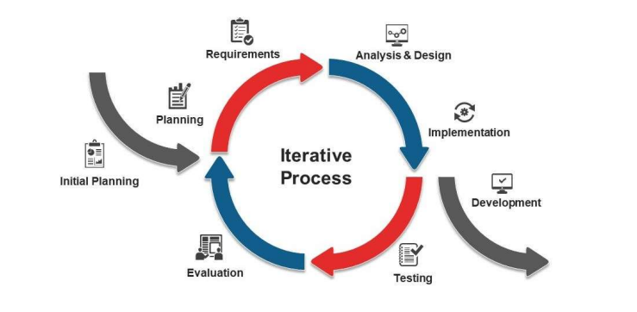
SOFTWARE DEVELOPMENT MODEL

Slide 32
SOFTWARE DEVELOPMENT MODEL
Iterative process starts with a simple implementation of a subset of the software requirements and iteratively enhances the evolving versions until the full system is implemented. At each iteration, design modifications are made and new functional capabilities are added. The basic idea behind this method is to develop a system through repeated cycles (iterative) and in smaller portions at a time (incremental).
Consider an iterative life cycle model which consists of repeating the following four phases in sequence: Requirements Phase: In the requirements phase of software development, the system related information is gathered and analyzed. The collected requirements are then planned accordingly for developing the system.

Slide 33
USE CASE

Slide 34
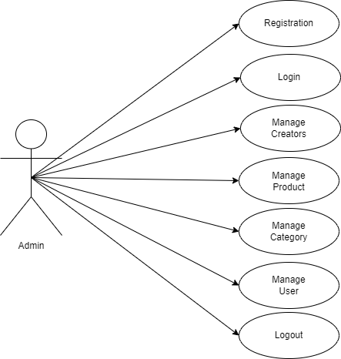
UsE CasE FOR ADMIN

Slide 35
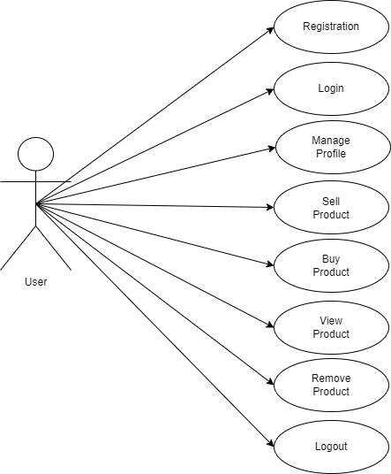
USE CASE FOR USER

Slide 36

USE CASE FOR CREATOR

Slide 37
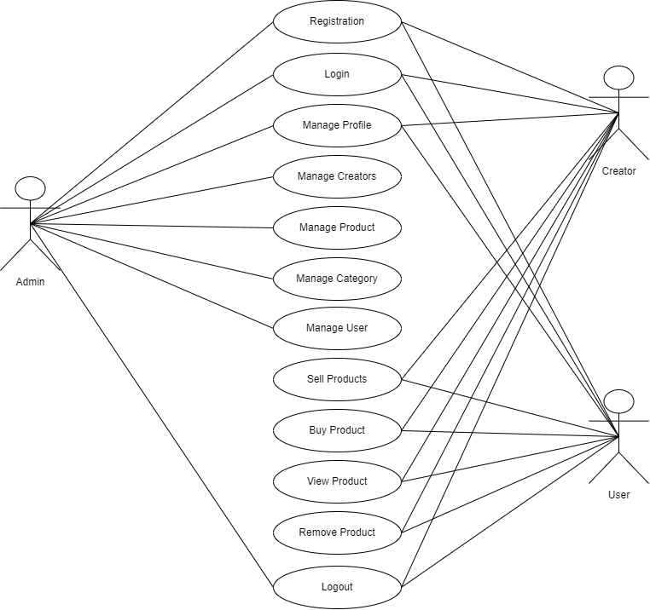
USE CASE FOR SYSTEM

Slide 38
ACTIVITY DIAGRAMs

Slide 39
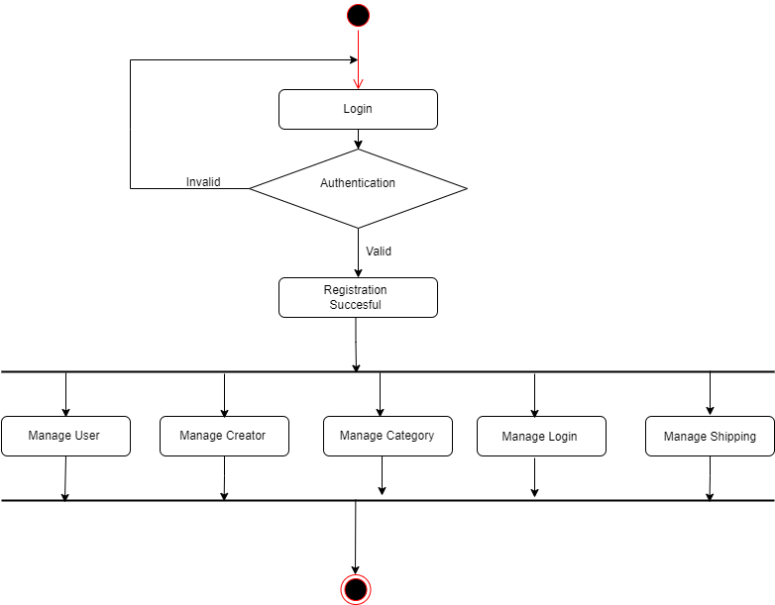
Activity diagraM FOR ADMIN

Slide 40
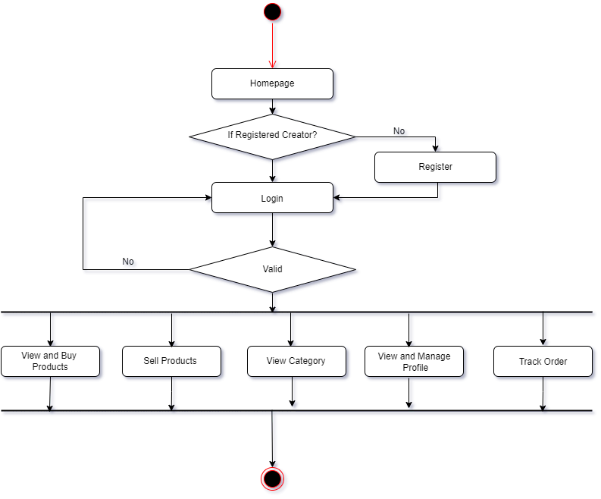
Activity diagraM FOR CREATOR

Slide 41
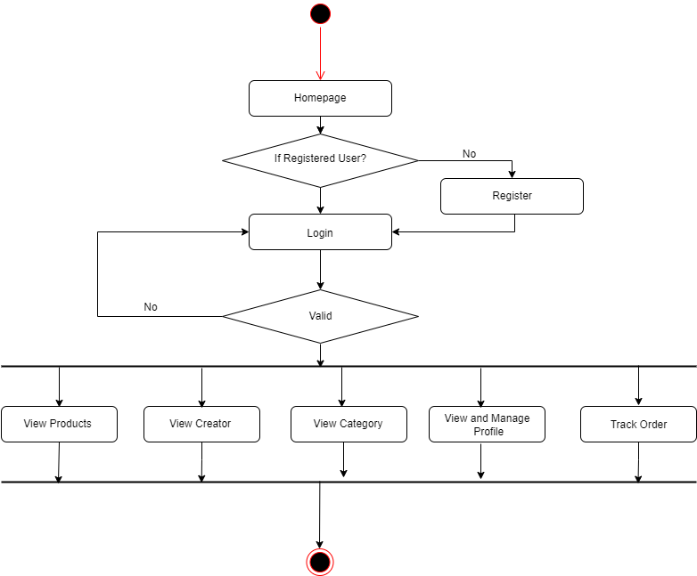
Activity diagraM FOR user

Slide 42
TIMELINE DIAGRAMs

Slide 43
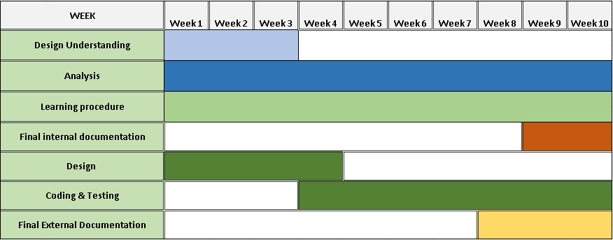
TIMELINE diagraM

Slide 44
SEQUENCE DIAGRAMs

Slide 45
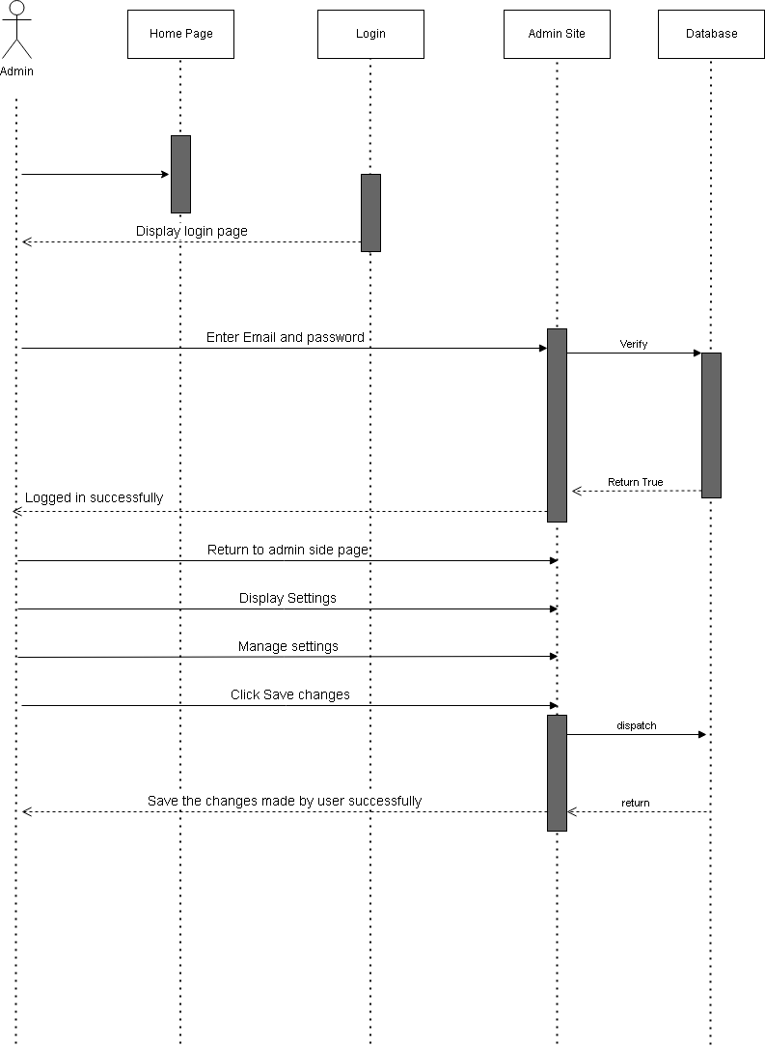
SEQUENCE DIAGRAMs

Slide 46
Data Dictionary

Slide 47
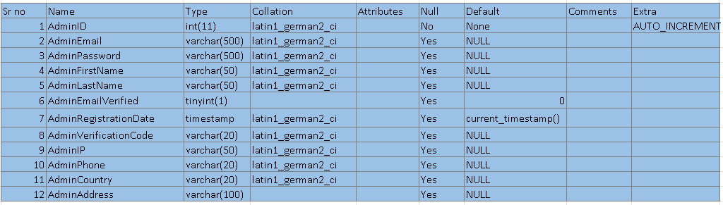
ADMIN TABLE

Slide 48
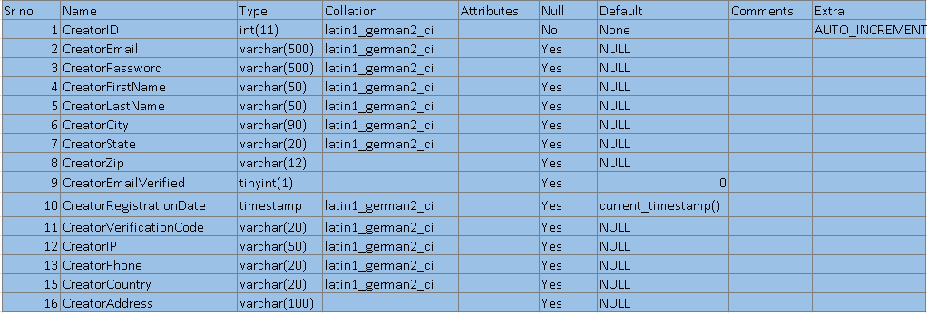
CREATOR TABLE

Slide 49
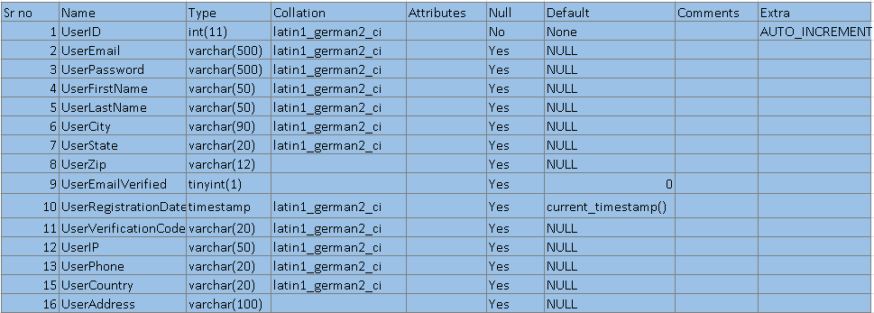
USER TABLE

Slide 50
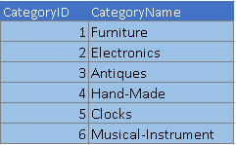
CATEGORY TABLE

Slide 51
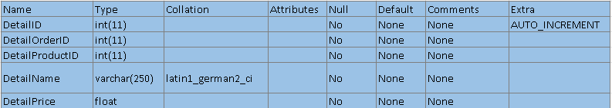
Order TABLE

Slide 52
ER DIAGRAM

Slide 53
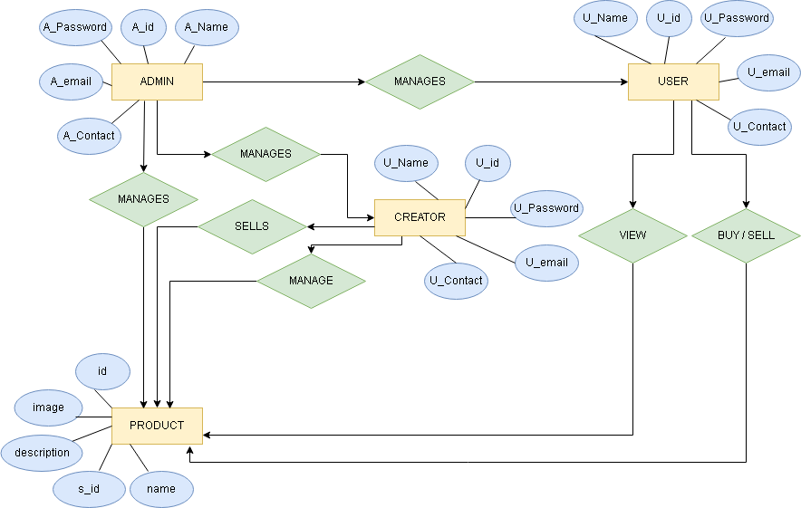
ER diagraM

Slide 54
DATA FLOW DIAGRAMs

Slide 55
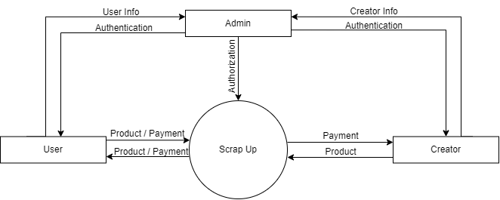
DFD LEVEL 0

Slide 56
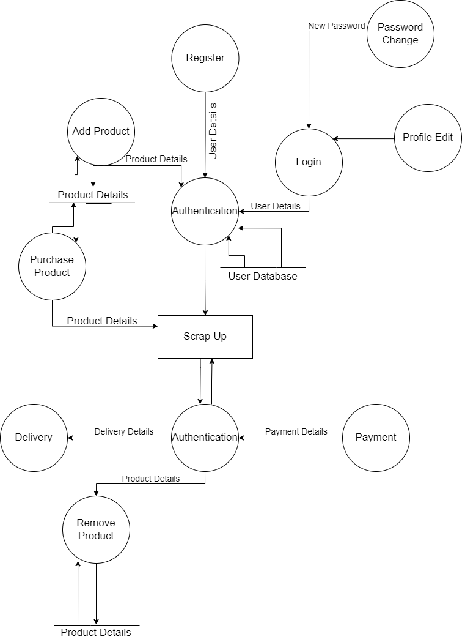
Dfd LEVEL 1

Slide 57
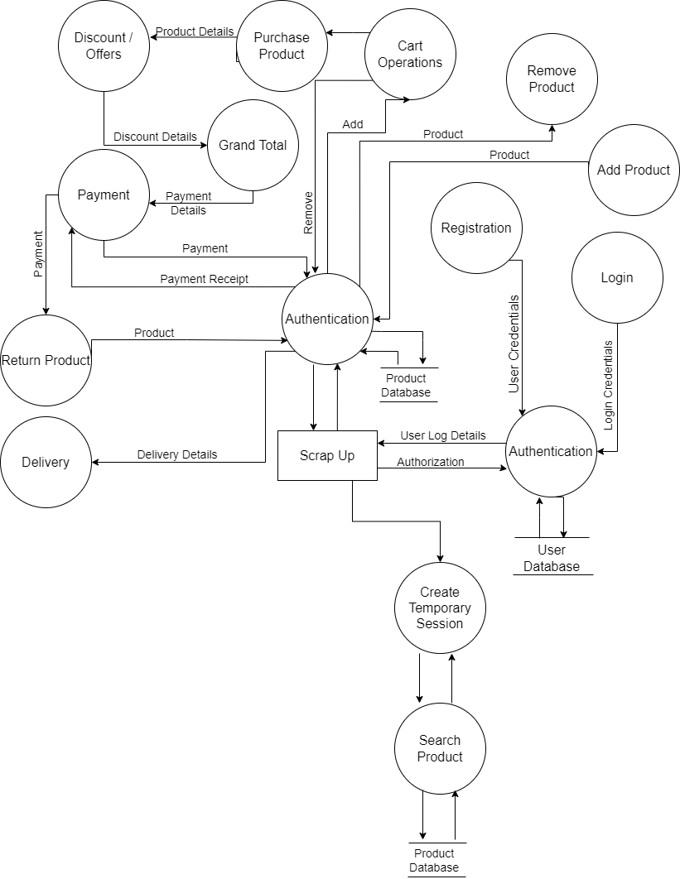
DFD LEVEL 2

Slide 58
MOCKUPS

Slide 59
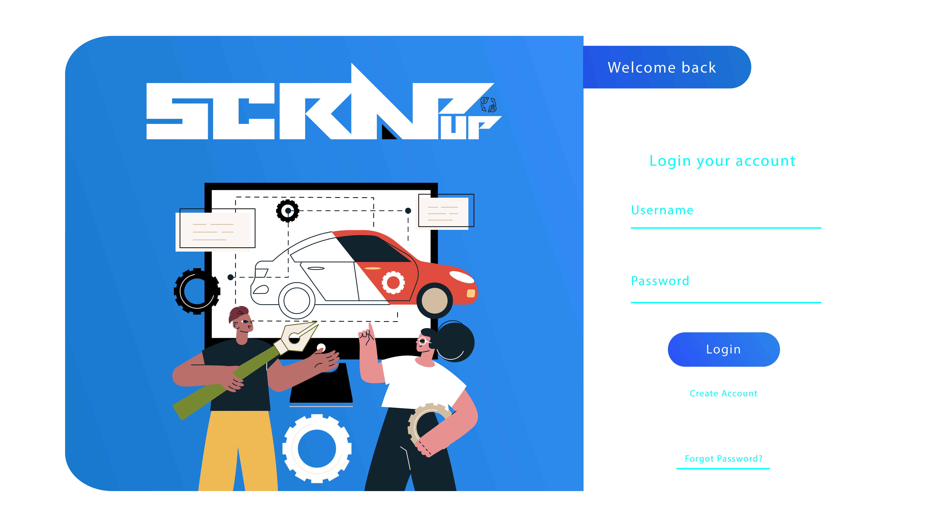
Login page

Slide 60
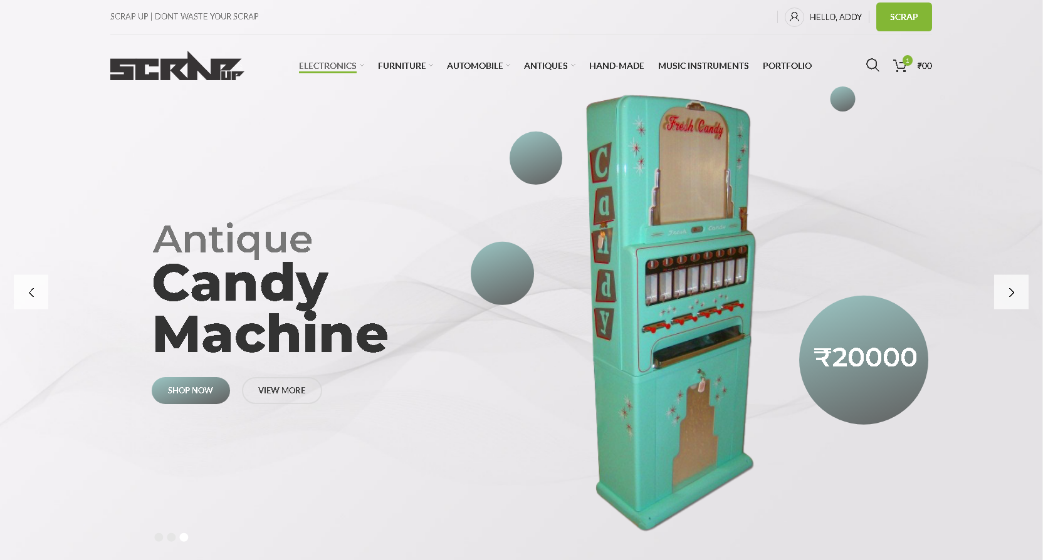
Home page

Slide 61
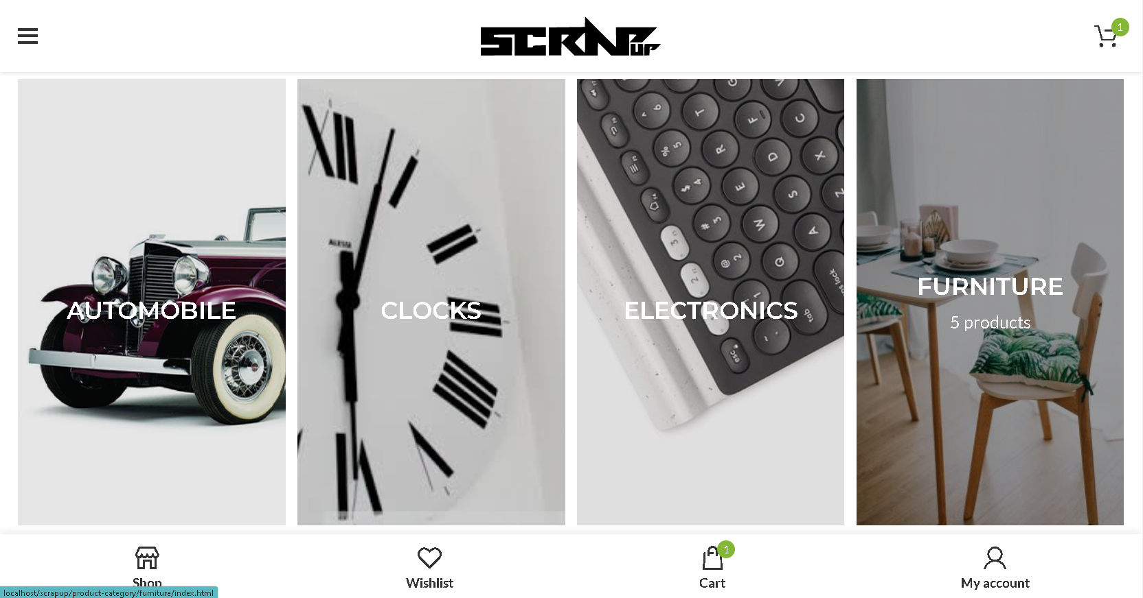
category section

Slide 62
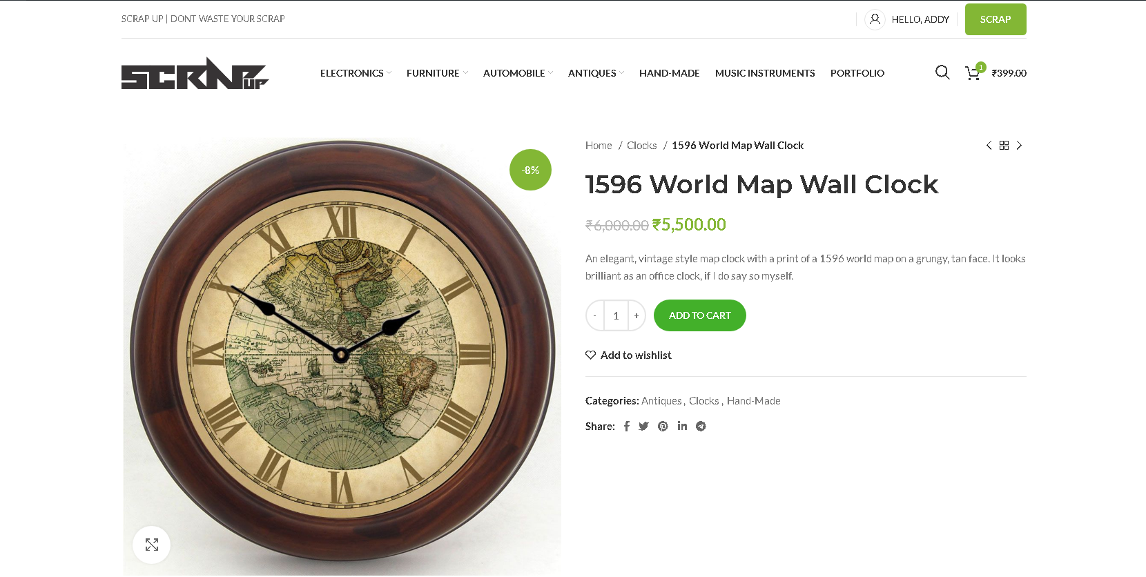
Product page

Slide 63
Future Enhancements

Slide 64
Future Enhancements
Scrap Up will offer the new feature In the future in which the user will be able to restore their old items in useful way so that they can make it possible to use it again.

Slide 65
Conclusion

Slide 66
Conclusion
Scrap Up is an emerging ecommerce website specifically made for reselling products that are no longer required or are waste for their previous owners, by reselling. Scrap Up provides an efficient way of waste management and contributes to sustainable development.
Scrap Up's USP is a special creator module that boosts employment opportunities to make old products that are to be resold, to make it better for future scope of usage through help of creative individuals working on their own or for the Scrap Up.

Slide 67
THANK YOU ☺

